Slide 1
Unsupervised methods – Dimension Reduction and Clustering
Business Analysis & Research, FMR India
Shovon Sengupta

Slide 2
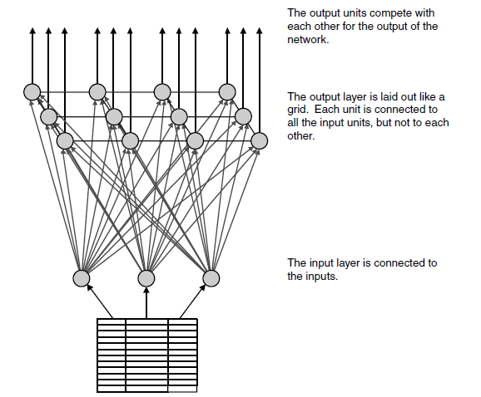
Self – Organizing Maps
What is SOM
Self-organizing maps (SOMs) are a variant of neural networks used for undirected data mining tasks such as cluster detection. The Finnish researcher Dr. Tuevo Kohonen invented self-organizing maps, which are also called Kohonen Networks. Although used originally for images and sounds, these networks can also recognize clusters in data. They are based on the same underlying units as feedforward, back propagation networks, but SOMs are quite different in two respects. They have a different topology and the back propagation method of learning is no longer applicable. They have an entirely different method for training.
The self-organizing map (SOM), an example of which is shown in, Fig – below is a neural network that can recognize unknown patterns in the data. Like the networks we’ve already looked at, the basic SOM has an input layer and an output layer. Each unit in the input layer is connected to one source, just as in the networks for predictive modeling. Also, like those networks, each unit in the SOM has an independent weight associated with each incoming connection (this is actually a property of all neural networks). However, the similarity between SOMs and feed-forward, back propagation networks ends here.
The output layer consists of many units instead of just a handful. Each of the units in the output layer is connected to all of the units in the input layer. The
output layer is arranged in a grid, as if the units were in the squares on a checkerboard. Even though the units are not connected to each other in this layer, the grid-like structure plays an important role in the training of the SOM, as we will see shortly.
.
How does an SOM recognize patterns? Imagine one of the booths at a carnival
where you throw balls at a wall filled with holes. If the ball lands in one of
the holes, then you have your choice of prizes. Training an SOM is like being
at the booth blindfolded and initially the wall has no holes, very similar to the
situation when you start looking for patterns in large amounts of data and
don’t know where to start. Each time you throw the ball, it dents the wall a little
bit. Eventually, when enough balls land in the same vicinity, the indentation
breaks through the wall, forming a hole. Now, when another ball lands at that
location, it goes through the hole. You get a prize—at the carnival, this is a
cheap stuffed animal, with an SOM, it is an identifiable cluster.
The SOM is a special kind of neural network that can be used to detect clusters
Notes:
Self-organizing maps, a type of neural network, can identify clusters but they do not identify what makes the members of a cluster similar to each other. A powerful technique for comparing clusters is to determine the center or average member in each cluster. Using the test set, calculate the average value for each feature in the data. These average values can then be displayed in the same graph to determine the features that make a cluster unique.
https://www.theseus.fi/bitstream/handle/10024/43792/thesis_Villejukarainen.pdf?sequence=1
Suggested by Teuvo Kohonen (Kohonen 1984) Kohonen Self-Organizing Map (SOM) is a topology-preserving unsupervised neural network that forms topological structure among the cluster units (Fausett 1994). This kind of network can be used to visualize and analyze high dimensional data, acquired by calculating and mapping the input data into clusters that present the typical cases. Because the training is performed unsupervised, no target outputs are required for teaching. Kohonen Self-Organizing Maps, see Figure 7, consists of m cluster units that are in one- or two-dimensional array, inputs are received as n-tuples (Kohonen 1989). This neural network approach differs from the previous ones introduced in the previous chapter by its structure because the SOM-layer also serves as an output.
Self-organizing maps can also be a hybrid-model. Together with other types of neural network layers, for example, Counter Propagation neural network (see Graupe 2007, 161 - 166). The network uses Kohonen-layer together with Grossberg-layer in which case the Kohonen-layer is used to cluster the similar clusters through the “Winner-Takes-All” method and then the Grossberg-layer is applied to calculate the wanted output. This setup enables the network to generalize received input.
Weight-vectors presenting each cluster in the network determine the sample input pattern matching the target cluster. Network is trained through “Winner-Takes-All”- method which means only the cluster-unit matching closest to the given input is chosen. In the beginning, no target outputs are given and the received input is treated as the desired output for the chosen cluster unit. Cluster units are called reference vectors in this work. Reference vector and its neighboring reference vectors are updated to match closer to the received input pattern. This closeness between input vector and each cluster is commonly determined by using the squared minimum Euclidean distance to decide which one is chosen as the winner. In the case where there is more than one equally distanced unit, the winner is decided by randomly choosing between matching units. So, for an input data vector x and reference vectors mi the best matching reference vector mc satisfies (Kohonen 1997)
C = argmin(||X – m||)
After determining the winner, neighboring cluster units that receive updates are decided by given radius R and the units found by using so called neighborhood function are updated. Suggested by Kohonen, the beginning of the radius should be around half of the largest dimension of the array.

Slide 3
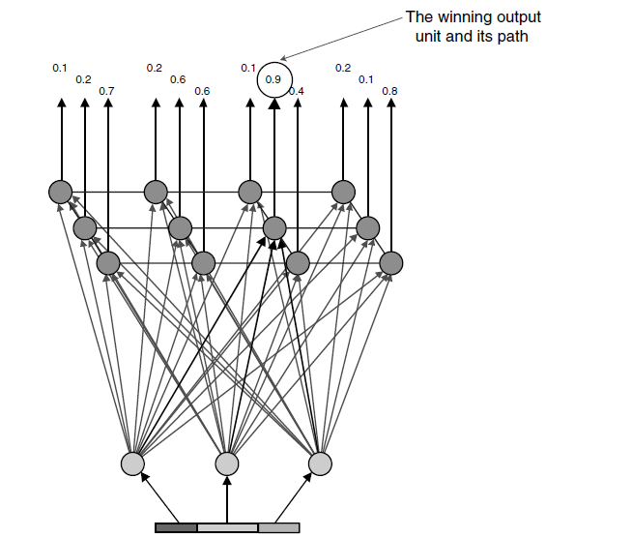
Self – Organizing Maps Contd..
What is SOM
Following figure shows how this works for a simple SOM. When a member of the training set is presented to the network, the values flow forward through the network to the units in the output layer. The units in the output layer compete with each other, and the one with the highest value “wins.” The reward is to adjust the weights leading up to the winning unit to strengthen in the response to the input pattern. This is like making a little dent in the network.
There is one more aspect to the training of the network. Not only are the weights for the winning unit adjusted, but the weights for units in its immediate
neighborhood are also adjusted to strengthen their response to the inputs. This adjustment is controlled by a neighborliness parameter that controls the
size of the neighborhood and the amount of adjustment. Initially, the neighborhood is rather large, and the adjustments are large. As the training continues, the neighborhoods and adjustments decrease in size. Neighborliness actually has several practical effects. One is that the output layer behaves more like a connected fabric, even though the units are not directly connected to each other. Clusters similar to each other should be closer together than more dissimilar clusters. More importantly, though, neighborliness allows for a group of units to represent a single cluster. Without this neighborliness, the network would tend to find as many clusters in the data as there are units in the output layer—introducing bias into the cluster detection.
Typically, a SOM identifies fewer clusters than it has output units. This is inefficient when using the network to assign new records to the clusters, since the new inputs are fed through the network to unused units in the output layer. To determine which units are actually used, we apply the SOM to the validation set. The members of the validation set are fed through the network, keeping track of the winning unit in each case. Units with no hits or with very few hits are discarded. Eliminating these units increases the run-time performance of the network by reducing the number of calculations needed for new instances. Once the final network is in place—with the output layer restricted only to the units that identify specific clusters—it can be applied to new instances. An unknown instance is fed into the network and is assigned to the cluster at the output unit with the largest weight. The network has identified clusters, but we do not know anything about them. We will return to the problem of identifying clusters a bit later.
The original SOMs used two-dimensional grids for the output layer. This was an artifact of earlier research into recognizing features in images composed of a two-dimensional array of pixel values. The output layer can really have any structure—with neighborhoods defined in three dimensions, as a network of hexagons, or laid out in some other fashion.
An SOM finds the output unit that does the best job of recognizing a particular input

Slide 4
Self – Organizing Maps Contd..
What is SOM
The Self-Organizing Map was developed by professor Kohonen. The SOM has been proven useful in many applications.
One of the most popular neural network models. It belongs to the category of competitive learning networks.
Based on unsupervised learning, which means that no human intervention is needed during the learning and that little needs to be known about the characteristics of the input data.
Use the SOM for clustering data without knowing the class memberships of the input data. The SOM can be used to detect features inherent to the problem and thus has also been called SOFM, the Self-Organizing Feature Map.
Provides a topology preserving mapping from the high dimensional space to map units. Map units, or neurons, usually form a two-dimensional lattice and thus the mapping is a mapping from high dimensional space onto a plane.
The property of topology preserving means that the mapping preserves the relative distance between the points. Points that are near each other in the input space are mapped to nearby map units in the SOM. The SOM can thus serve as a cluster analyzing tool of high-dimensional data. Also, the SOM has the capability to generalize.
Generalization capability means that the network can recognize or characterize inputs it has never encountered before. A new input is assimilated with the map unit it is mapped to.

Slide 5
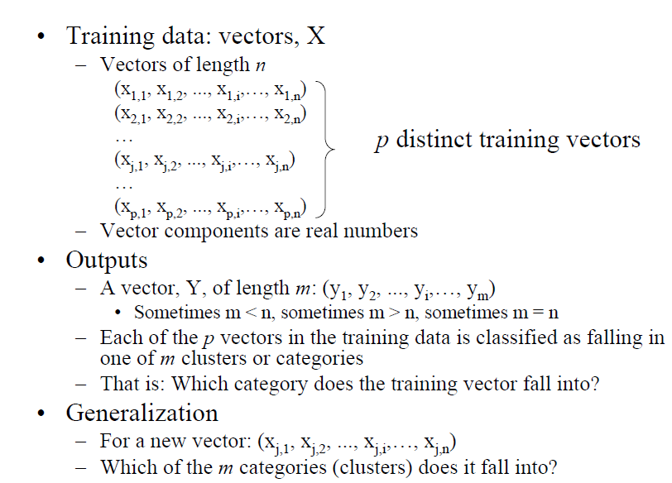
Self – Organizing Maps Contd..
Input & Output

Slide 6
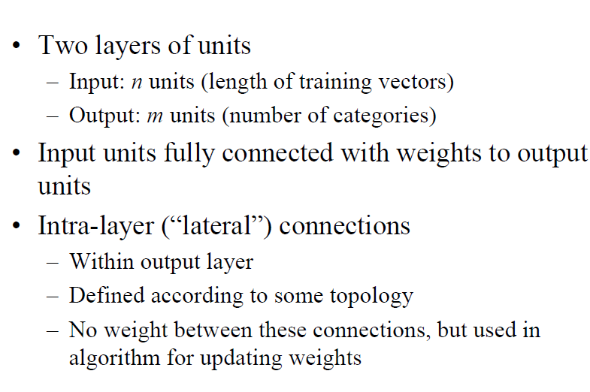
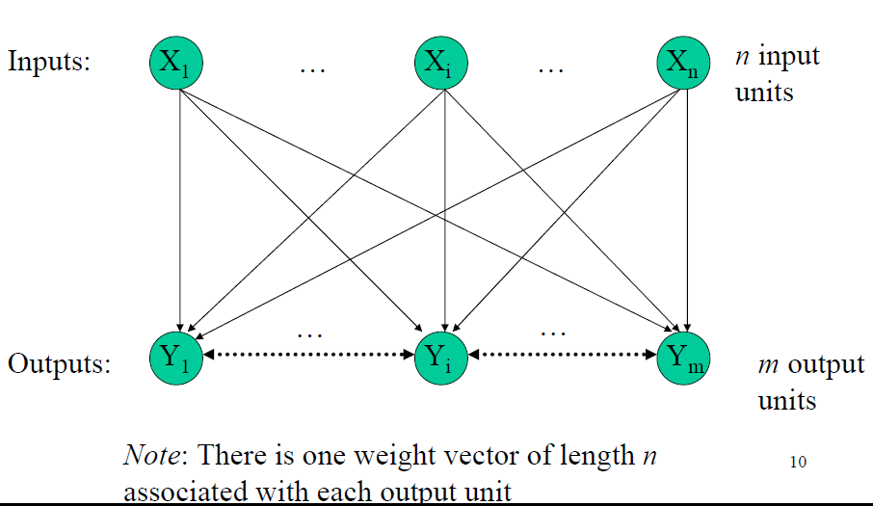
Self – Organizing Maps Contd..
Network Architecture

Slide 7
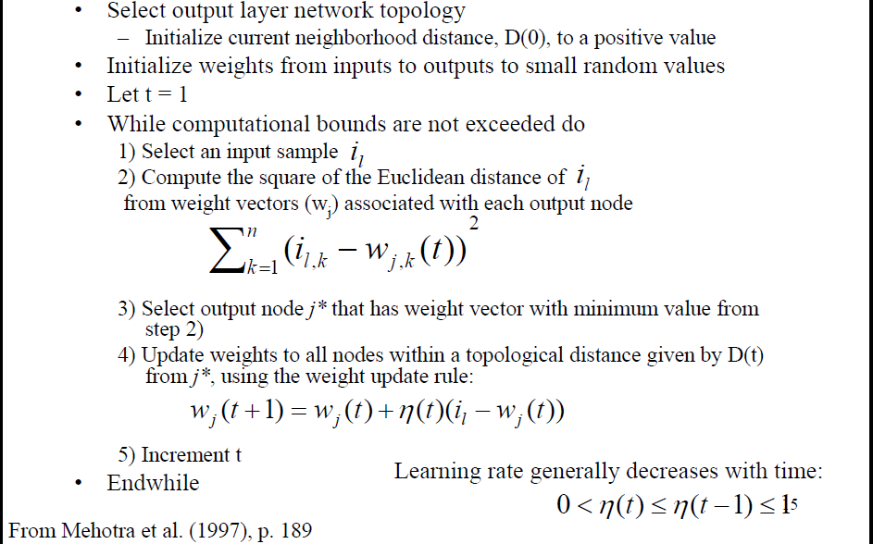
Self – Organizing Maps Contd..
SOM Algorithm
Notes:
https://genome.tugraz.at/MedicalInformatics2/SOM.pdf

Slide 8
Various unsupervised dimension reduction methods.
Overview
PCA – In a nutshell, PCA aims to find the directions of maximum variance in high-dimensional data and projects it onto a new subspace with equal or fewer dimensions that the original one.
Kernel PCA – kernel PCA uses kernel trick to perform a nonlinear mapping that transforms the data onto a higher-dimensional space and use standard PCA in this higher-dimensional space to project the data back onto a lower-dimensional space where the samples can be separated by a linear classifier (under the condition that the samples can be separated by density in the input space).
Incremental PCA – One problem with the preceding implementation of PCA is that it requires the whole training set to fit in memory in order for the SVD algorithm to run. Fortunately, Incremental PCA (IPCA) algorithms have been developed: you can split the training set into mini-batches and feed an IPCA algorithm one mini-batch at a time. This is useful for large training sets, and also to apply PCA online (i.e., on the fly, as new instances arrive).
Randomized PCA – This is a stochastic algorithm that quickly finds an approximation of the first d principal components. Its computational complexity is O(m × d2) + O(d3), instead of O(m × n2) + O(n3), so it is dramatically faster than the previous algorithms when d is much smaller than n.
Other types of Manifold Learning algo(s):
MDS (Multi Dimensional Scaling) - Although, PCA tries to use optimization for retained variance, multidimensional scaling (MDS) tries to retain the relative distances as much as possible when reducing the dimensions. This is useful when we have a high-dimensional dataset and want to get a visual impression.
MDS does not care about the data points themselves; instead, it's interested in the dissimilarities between pairs of data points and interprets these as distances. The first thing the MDS algorithm is doing is, therefore, taking all the N data points of dimension k and calculates a distance matrix using a distance function o d , which measures the (most of the time, Euclidean) distance in the original feature space:
Now, MDS tries to position the individual data points in the lower dimensional space such that the new distance there resembles the distances in the original space as much as possible. As MDS is often used for visualization, the choice of the lower dimension is most of the time two or three.
.

Slide 9
Various unsupervised dimension reduction methods… Contd.
Overview
ISOMAP – MDS and PCA are not a wise choice for dimensionality reduction when the points have a complicated , non-linear relationship to one another ( An exception is kernel PCA). ISOMAP which is an extension of the traditional MDS , was developed to handle such datasets. Algorithm for ISOMAP can be summarized as:
Find the nearest neighbours of each data point and create a weighted graph by connecting a point to its nearest neighbours. The nodes are the data points and the weights of the links are the distances between points.
Redefine the distances between points to be the length of the shortest path between two points in the neighborhood graph.
Apply Classical MDS to the new distance matrix.
Locally Linear Embedding - Locally Linear Embedding (LLE) is a very powerful nonlinear dimensionality reduction (NLDR) technique. It is a Manifold Learning technique that does not rely on projections like PCA or Kernel PCA. In a nutshell, LLE works by first measuring how each training instance linearly relates to its closest neighbors (c.n.), and then looking for a low-dimensional representation of the training set where these local relationships are best preserved. This makes it particularly good at unrolling twisted manifolds, especially when there is not too much noise.
Apart from the traditional version of the LLE, We have also used Modified Locally Linear Embedding (MLLE) , Hessian Eigen mapping and combined(ensemble) dimension reduction methods (like combining two DR method together)
Auto-Encoder – If the auto encoder uses only linear activations and the cost function is the Mean Squared Error (MSE), then it can be shown that it ends up performing Principal Component Analysis. We have a much more detailed module on Auto-Encoder.
tSNE – t-distributed stochastic neighborhood embedding (tSNE is a (prize-winning) technique for dimensionality reduction that is particularly well suited for the visualization of high-dimensional datasets. The technique can be implemented via Barnes-Hut approximations, allowing it to be applied on large real-world datasets.
Notes:
Some important Links –
https://lvdmaaten.github.io/tsne/

